Slide 1


Probabilistic Noninterference
به نام خدا
Seyed Mohammad Mehdi Ahmadpanah
smahmadpanah@aut.ac.ir
Supervisor
Dr. Mehran S. Fallah
Formal Security Lab.
Amirkabir University of Technology
August 13, 2016

Slide 2
Outline
Introduction
Preliminaries
Literature Review
Probabilistic Noninterference for Multithreaded Programs
Conclusion

Slide 3
Introduction
Noninterference
Confidentiality
Extensional
Nondeterminism
Multi-Threading and Thread Scheduling
Possibilistic vs. Probabilistic
Motivation
Notes:
[11]
Goguen and Meseguer → in the context of deterministic multi-user system → “One group of users is noninterfering with another group of users if what
the first group does has no effect on what the second group of users can see.
Language-based setting of NI by Volpano and Smith and Irvine:
Assuming the program memory is separated into a low, or public, part, which an attacker is able to observe, and a high, or private, part, hidden to the attacker, a sequential program satisfies noninterference if, upon running it, the high part of the initial memory does not affect the low part of the resulting memory.
Concurrency → generalization of the notion → Possibilistic NI:
if an execution allowing certain observations by the attacker is possible, then another execution for which these observations are infirmed (insecure) is also possible.
Drawbacks: running multiple times and getting statistical information and refinement attacks via knowledge of the thread scheduling.
Probabilistic NI: Given the nondeterminism associated with multi-threading,
and our assumption that thread scheduling is probabilistic,
we require more precisely that changing the initial values of
H variables cannot affect the joint probability distribution
of the possible final values of L variables; this property is
called probabilistic noninterference.
Possibilistic is a weaker property than probabilistic.
Scheduler is not in the language semantics and is part of the runtime environement usually not known when a program is analyzed

Slide 4
Preliminaries
Bisimulation
Weak Bisimulation
Noninterference Notions
Attacker Observation (internal, external)
Classification of Flows
Type System

Slide 5
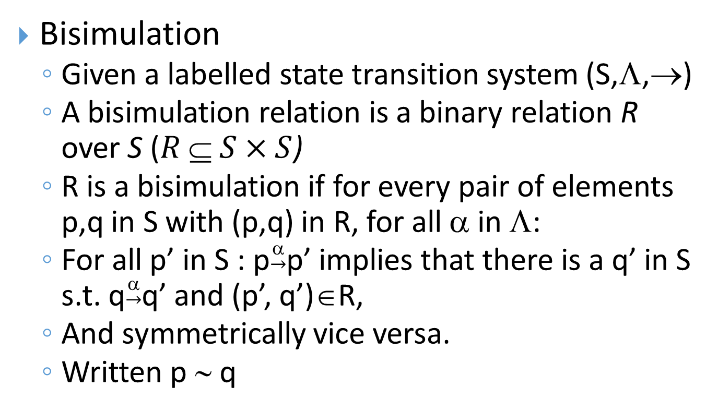
Bisimulation
Bisimulation
Given a labelled state transition system (S,Λ,→)
A bisimulation relation is a binary relation R over S ($R  S×S$)
R is a bisimulation if for every pair of elements p,q in S with (p,q) in R, for all α in Λ:
For all p’ in S : p$\underset{→}{α}$p’ implies that there is a q’ in S s.t. q$\underset{→}{α}$q’ and (p’, q’)∈R,
And symmetrically vice versa.
Written p ∼ q
Notes:
a bisimulation is a binary relation between state transition systems, associating systems that behave in the same way in the sense that one system simulates the other and vice versa.
Intuitively two systems are bisimilar if they match each other's moves. In this sense, each of the systems cannot be distinguished from the other by an observer.

Slide 6
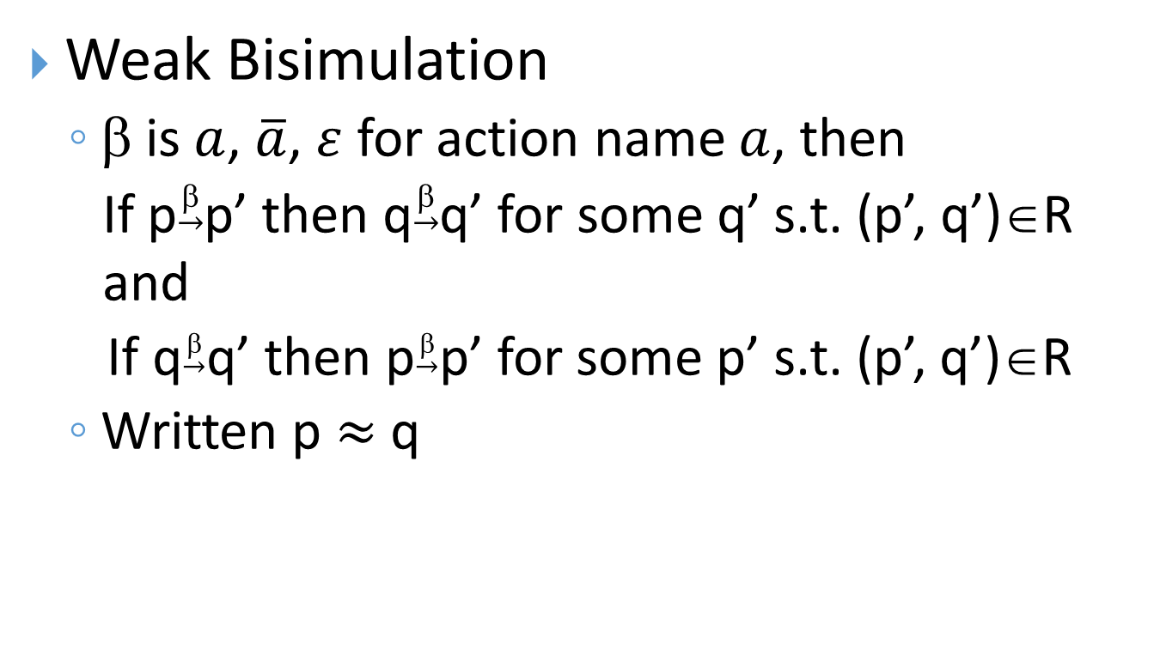
Bisimulation
Weak Bisimulation
β is $a$, $\overline{a}$, $ε$ for action name $a$, then
If p$\underset{→}{β}$p’ then q$\underset{→}{β}$q’ for some q’ s.t. (p’, q’)∈R and
If q$\underset{→}{β}$q’ then p$\underset{→}{β}$p’ for some p’ s.t. (p’, q’)∈R
Written p $≈$ q

Slide 7
Noninterference Notions
Noninterference Notions
Self Isomorphism
Discreetness (highness)
Self Strong Bisimilarity (Strong Security)
01-Bisimilarity
Weak Bisimilarity
Attacker
External (stop-watch) vs. Internal
Program Counter

Slide 8
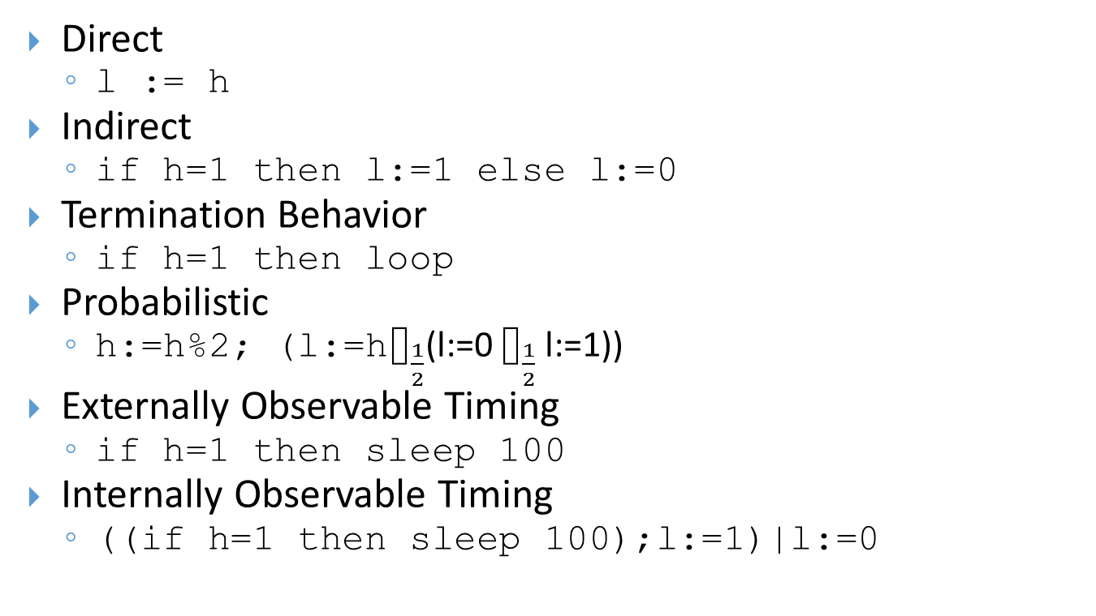
Classification of Flows
Direct
l := h
Indirect
if h=1 then l:=1 else l:=0
Termination Behavior
if h=1 then loop
Probabilistic
h:=h%2; (l:=h$⌷_{\frac{1}{2}}$(l:=0 $⌷_{\frac{1}{2}}$ l:=1))
Externally Observable Timing
if h=1 then sleep 100
Internally Observable Timing
((if h=1 then sleep 100);l:=1)|l:=0

Slide 9
Desired Properties
Desired properties of an approach to information flow for multithreaded programs [10]
Permissiveness
Scheduler-Independence
Standard Semantics
Language Expressiveness
Practical Enforcement
Notes:
• Permissiveness The presence of multithreading enables
new attacks which are not possible for sequential
programs. The challenge is to reject these attacks without
compromising the permissiveness of the model. In
other words, information flow models should accept as
many intuitively secure and useful programs as possible.
• Scheduler-independence The security of a given program
should not critically depend on a particular
scheduler [26]. Scheduler-dependent security models
suffer from the weakness that security guarantees may
be destroyed by a slight change in the scheduler policy.
Therefore, we aim at a security condition that is robust
with respect to a wide class of schedulers.
• Standard semantics Following the philosophy of extensional
security [17], we argue for security defined
in terms of standard semantics, as opposed to
security-instrumented semantics. If there are some
non-standard primitives that accommodate security,
they should be clearly and securely implementable.
• Language expressiveness A key to a practical security
model is an expressive underlying language. In particular,
the language should be able to treat dynamic
thread creation, as well as provide possibilities for synchronization.
• Practical enforcement Another practical key is a
tractable security enforcement mechanism. Particularly
attractive is compile-time automatic compositional
analysis. Such an analysis should nevertheless
be permissive, striving to trade as little expressiveness
and efficiency for security as possible.

Slide 10
Literature Review
Probabilistic Noninterference in a Concurrent Language – Volpano and Smith – 1999
First notion of Probabilistic NI
Internal program behavior
A type system
Uniform scheduler
Every conditional with a guard containing high variables must be executed atomically
protect
The guard of a while-loop must be L

Slide 11
Literature Review (Cont.)
Transforming out Timing Leaks – Agat - 2000
Timing leakages to external observer
covert timing channel
A type system + A type-directed transformation
By padding with dummy instructions where needed

Slide 12
Literature Review (Cont.)
Probabilistic Noninterference for Multi-threaded Programs–Sabelfed and Sands – 2000
Internal timing behavior
Strong Security
Compositional
Scheduler-Independent
Agat’s Approach
Combination of Typing and Code Transformation
Elimination of protect
Will be discussed later...
Notes:
proved that the strong security condition is the weakest compositional property that implies information flow security for the natural class of schedulers.

Slide 13
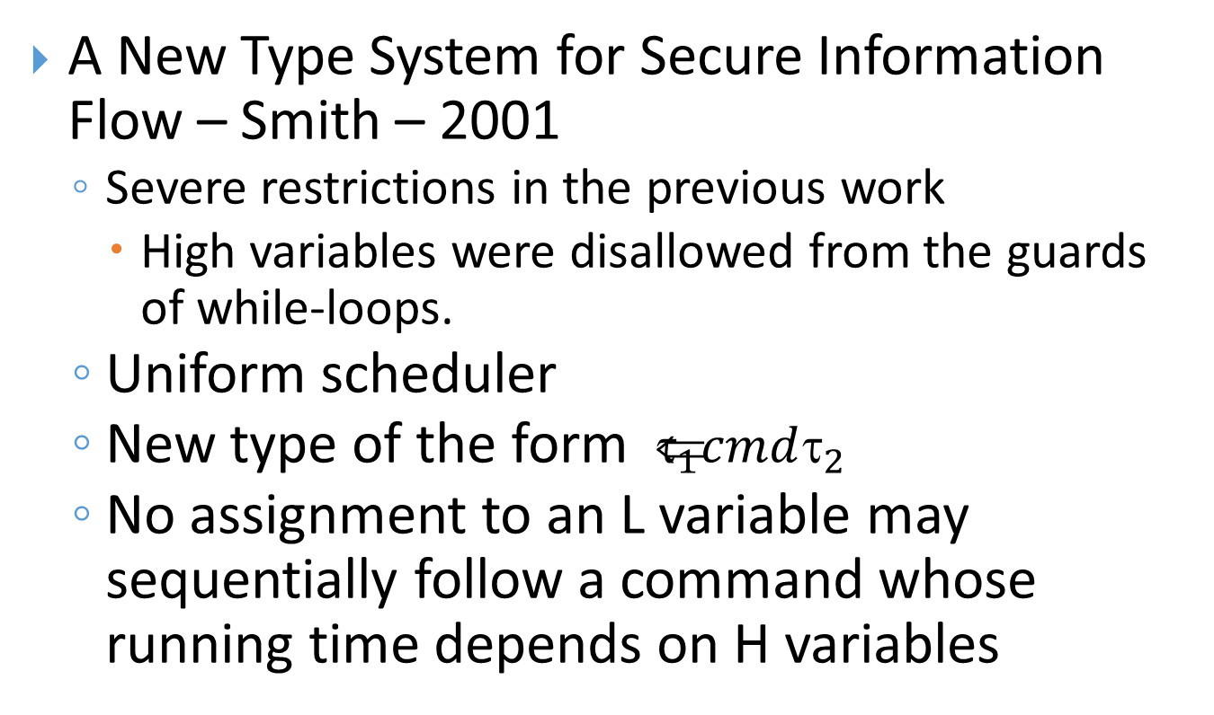
Literature Review (Cont.)
A New Type System for Secure Information Flow – Smith – 2001
Severe restrictions in the previous work
High variables were disallowed from the guards of while-loops.
Uniform scheduler
New type of the form $ _{1}cmd_{2}$
No assignment to an L variable may sequentially follow a command whose running time depends on H variables
Notes:
this type says that the command assigns only to
variables of level T1 (or higher) and has running time that
depends only on variables of level T2 (or lower).

Slide 14
Literature Review (Cont.)
Probabilistic Noninterference through Weak Probabilistic Bisimulation – Smith – 2003
Weak probabilistic bisimulation for Markov chains
More relax with respect to timing
A type system
Supporting fork command that allows new threads to be spawned (Dynamic Thread Creation)
Notes:
probabilistic bisimulation is too strict with the respect to timing (previous work)
probabilistic bisimulation cannot accommodate threads whose running time depends on H variables.
this paper proposes a notion of weak probabilistic bisimulation for Markov chains, allowing two Markov chains to be regarded as equivalent even when one “runs” more slowly than the other.
allows the running times of threads to depend on the values of H variables,
so long as these timing variations do not affect the values of L variables.

Slide 15
Literature Review (Cont.)
Observational Determinism for Concurrent Program Security– Zdancewic and Myers – 2003
Immune to internal timing attacks and to attacks that exploit information about the thread scheduler
A type system and A race-freedom analysis
Two arbitrary initial configuration that the low observer cannot distinguish must produce indistinguishable traces
Notes:
The definition based on Observational Determinism has the advantage over possibilistic properties that it is immune to refinement attacks
Although the security property is strong, it also avoids
some of the restrictiveness imposed on previous security-typed
concurrent languages.

Slide 16
Literature Review (Cont.)
Improved Typings for Probabilistic Noninterference in a Multi-Threaded Language- Smith – 2006
A more permissive type system
Internal leaks
Integrates the two previous work of Smith!

Slide 17
Literature Review (Cont.)
Noninterference for Concurrent Programs and Thread Systems – Boudol and Castellani - 2006
A type system for controlled thread systems
Handling scheduling entirely within a possibilistic setting
Dynamic creation is not supported
if the termination of certain threads would be signaled to the scheduler, then controlled thread systems writing public variables cannot be typed.
Non-standard restriction
based on an operational semantics for the scheduler
Notes:
propose a security type system for controlled thread
systems that consist of a thread pool and a scheduler. If a controlled thread sys-
tem is typable, then the thread pool is secure under the scheduler.
the approach requires the size of a thread pool to remain fixed during
a program run: dynamic thread creation is not supported and threads remain in
the thread pool upon termination
This is a non-standard restriction, as schedulers typically use
the number of live threads when choosing the next thread.

Slide 18
Literature Review (Cont.)
Securing Interaction between Threads and the Scheduler– Russo and Sabelfeld – 2006
Revisit the goal set (mentioned before)
A permissive NI-like security specification
A compositional type system
guarantees security for a wide class of schedulers
Language with primitives for raising and lowering the security level of threads
Termination-Insensitive security with respect to a class of deterministic schedulers
hide and unhide a thread
Scheduler with a non-standard interface must be used
Notes:
Existing approaches to specifying and enforcing information-flow
security often suffer from over-restrictiveness, relying on
non-standard semantics, lack of compositionality, inability
to handle dynamic threads, scheduler dependence, and
efficiency overhead for code that results from securityenforcing
transformations.
the scheduler guarantees
that during the execution of hidden threads no other thread is scheduled.

Slide 19
Literature Review (Cont.)
Security for Multithreaded Programs under Cooperative Scheduling – Russo and Sabelfeld – 2006
A transformation that eliminates the need for protect under cooperative scheduling
A wide class of schedulers
Both Termination-Sensitive and Termination-Insensitive security
yield command
Supporting dynamic thread creation
Notes:
due to cooperative scheduling, only termination or a yield by a thread may change the decision of the scheduler which thread to run next
The transformation injects yield commands in such a way that threads may not
yield whenever their timing information depends on secret data.
yield is when thread gives up its time slice.
It provides a program transformation
that introduces yield-statements into a program instructing the scheduler to se-
lect another thread, such that no yield-statements occur during computations
depending on secrets, and rescheduling only occurs after a yield-statement

Slide 20
Literature Review (Cont.)
Flexible Scheduler-Independent Security– Mantel and Sudbrock- 2010
Permits nondeterminism in a program’s observable behavior without requiring a restrictive lock-step indistinguishability
No require non-standard modifications
Identification of a suitable class of schedulers that covers the most relevant schedulers
Robust schedulers e.g. uniform and RoundRobin
A type system
Notes:
Identification of a suitable class of schedulers that covers the most relevant schedulers
Two main approaches
Observational Determinism [1]
Intuitively secure programs can have nondeterministic public output
Strong Security [3]
Restrictive lock-step indistinguishability
Even if differences in the timing do not cause difference in the public!
Very Restrictive
So far, there are two main approaches to defining information flow properties
that are scheduler independent, Firstly, requiring that a program's public out-
put is deterministically determined by the program's public input and, secondly,
requiring that a program's possible behaviors for any two inputs, which com-
prise identical public inputs, are stepwise indistinguishable to an observer of the
program's public outputs.
Observational Determinism:Forbid nondeterminism in the publicly observable behavior of a program
. The existence of a scheduler-independent security property with these
features is somewhat surprising given that Sabelfeld proved in [10] that strong
security is the weakest property that implies information ow security for a nat-
ural class of schedulers.
Reject execute programs containing threads that assign to low
variables after performing computations whose runtime depends on high data
(hiding the thread during those computations)

Slide 21
Literature Review (Cont.)
Noninterfering Schedulers – Popescu, Holzl and Nipkow – 2013
A framework for expressing and analyzing the behavior of probabilistic schedulers
if a multi-threaded program is possibilistically noninterfering, then it is also probabilistically noninterfering when run under the given scheduler
covers dynamic thread creation
allows timing of thread execution to depend on high data
free from the termination assumption of the program
Notes:
Its main contributions are:
– A framework for analyzing schedulers independently from the concrete operational
semantics of threads.
– A notion of noninterfering scheduler obtained by a novel reading, in a probabilistic
key, of G&M’s seminal notion.
– A result inferring probabilistic noninterference from possibilistic noninterference
under the assumption of a noninterfering scheduler (for suitable notions of possibilistic
and probabilistic noninterference).
Mantel conditioned by termination of the program, our is freeness from the termination assumption which is both hard to check and often not true.
We call the scheduler noninterfering if the observation
of each visible thread v is independent of the actions of the invisible threads I,
i.e., the exit probability of v through I is the same as the probability of taking v provided
I were completely inexistent (including from the execution history).
We have not introduced novel notions of possibilistic or probabilistic
noninterference,
Sabelfeld [15] proves that strong security cannot
be weakened if we are after a compositional notion covering the whole class of
schedulers. Z

Slide 22
Literature Review (Cont.)
Formal Verification of Language-Based Concurrent Noninterference – Popescu, Holzl and Nipkow – 2013
compositionality techniques for proving possibilistic NI for a while language with parallel composition
systemizing and comparing existing type-based NI notions
formalism and theorems have been verified in Isabelle/HOL

Slide 23
Literature Review (Cont.)
Formalizing Probabilistic Noninterference – Popescu, Holzl and Nipkow – 2013
an Isabelle formalization of probabilistic NI for a multi-threaded language with uniform scheduling
resumption-based (bisimulation-based) and trace-based notions of NI
no support for dynamic thread creation
Notes:
probabilistic behavior comes from both the scheduler
and the individual threads,

Slide 24
Literature Review (Cont.)
Hybrid Monitors for Concurrent Noninterference – Askarov, Chong and Mantel – 2015
A monitoring framework to enforce strong security
hybrid = dynamic + static program analysis
each thread is guarded by its own local monitor, and a single global monitor
flow-sensitive progress-sensitive information flow control

Slide 25
Literature Review (Cont.)
Specification and Static Enforcement of Scheduler-Independent Noninterference in a Middleweight Java– Iranmanesh and Fallah – 2016
introduce a new timing covert channel arises from the interplay between multithreading and object-orientation
multithreading + Middleweight Java
Scheduler-independent
A more permissive NI
A type system
Notes:
If the timing behavior of a thread depends on sensitive information, the run of that thread may induce timing channels.
In this paper, we focus on internal timing channels. There are, in general, three principal classes of methods for eliminating such covert channels. The protection/hiding-based methods are intended to devise schedulers that hide security-critical timing behavior of threads [5,13–16]. The second class is comprised of external-timing-based methods that add dummy computations to a leaky construct [3,17–19]. Low-determinism-based methods constitute another class in which any race on low values is prevented [4,20,21].

Slide 26
Recall
Probabilistic Noninterference for Multi-threaded Programs–Sabelfed and Sands – 2000
Internal timing behavior
Strong Security
Compositional
Scheduler-Independent
Agat’s Approach
Combination of Typing and Code Transformation
Elimination of protect

Slide 27


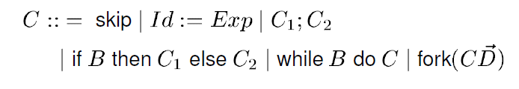
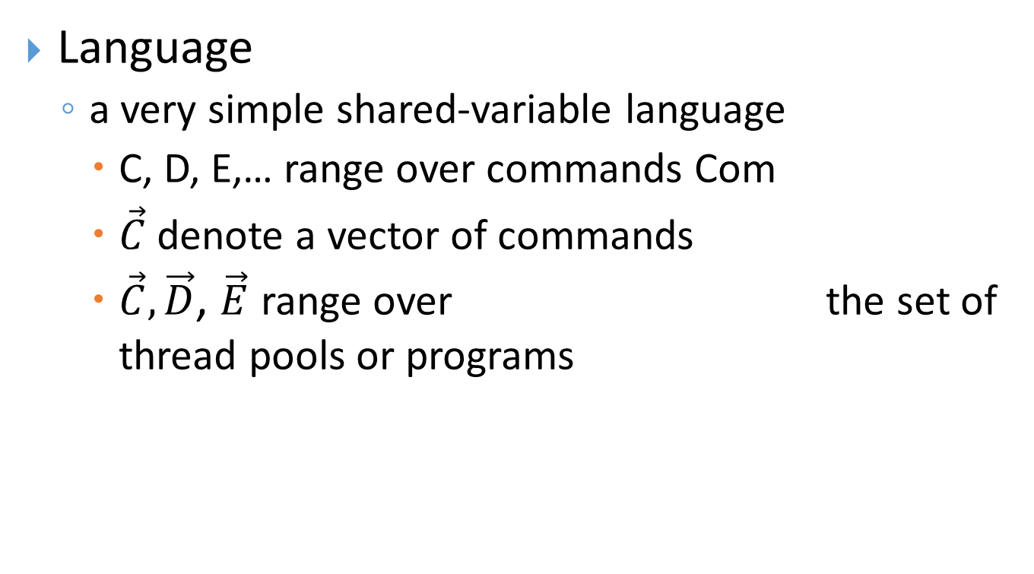
Probabilistic NI for Multi-threaded Programs
Language
a very simple shared-variable language
C, D, E,… range over commands Com
$\vec{C}$ denote a vector of commands
$\vec{C},\vec{D}$, $\vec{E}$ range over the set of thread pools or programs

Slide 28
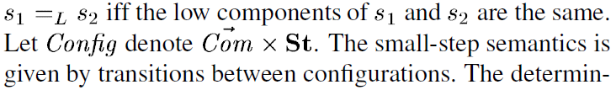
Language (Cont.)
small-step semantics
configuration c is a pair of a command and a state (memory).
state s∈St is a finite mapping from variables to values
Low-equivalence

Slide 29
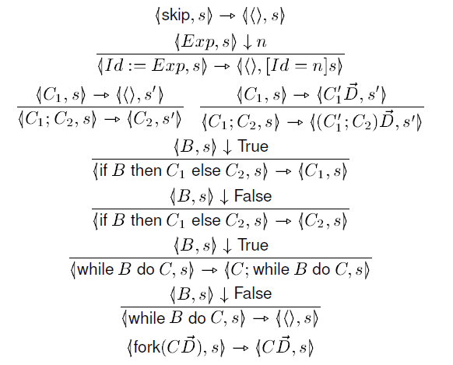
Small-step Semantics

Slide 30
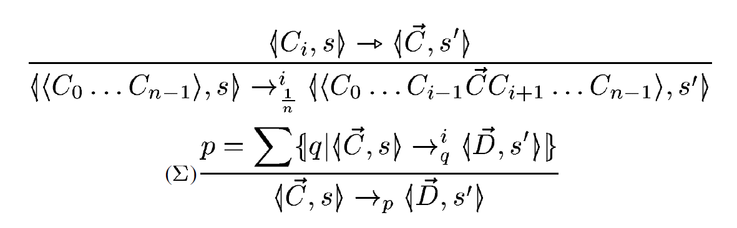


Uniform Probabilistic Semantics of thread pools
The probabilistic semantics satisfies the following “soundness” properties for all nonterminal programs $\vec{C}$

Slide 31



Probabilistic NI
A distribution μ of a set X (write ) is a function μ∈X→[0,1] s.t.
A probabilistic state μ is a distribution of configurations
Modelled by a Markov chain of probabilistic states
Every following probabilistic state μ’ is computed by multiplying the row vector of probabilities from μ by the stochastic transition matrix T
Notes:
Volpano and Smith's noninterference is
based on a lock-step execution of probabilistic states

Slide 32

Probabilistic NI (Cont.)
The rows and columns of T correspond to possible configurations reachable from the initial one
The element T(i,j) are the probability of a transition from configuration i to configuration j
Notes:
From the point of view of the low observer two probabilistic states are indistinguishable iff projecting
out high variables makes the two states the same
probabilistic noninterference condition for a program C

Slide 33

Relational Definitions and Notation
partial equivalence relation (PER) on A
a binary relation on A which is symmetric and transitive
Domain and Range of a PER P are both equal to dom(P)

Slide 34



Probabilistic Bisimulation
An unlabeled probabilistic transition system is a set of states S and a set of transitions of the form s→μ where s∈S and μ∈𝒟(S).
Notes:
small-step semantics transitions from a conguration c to a set of configurations S

Slide 35


Probabilistic Bisimulation (Cont.)
Definition1 – An equivalence relation R∈Rel(Config) is a probabilistic bisimulation if whenever c R d then
Definition2- A PER R∈Rel(Config) is a partial probabilistic bisimulation if whenever c R d then
Proposition1- R is a partial probabilistic bisimulation implies R* a probabilistic bisimulation.
Notes:
we will use a weakening of the denition
of probabilistic bisimulation by relaxing the reexivity
condition.

Slide 36
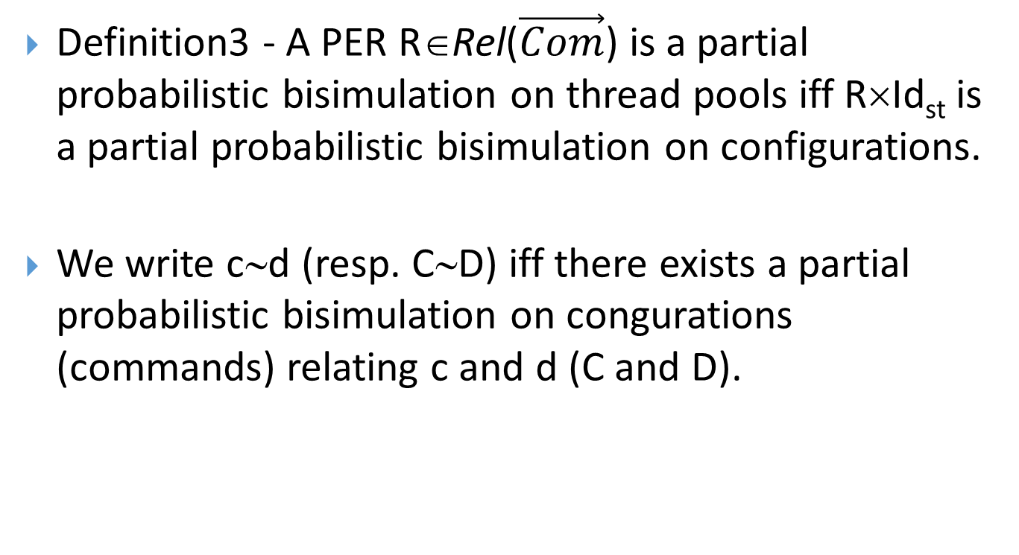
Probabilistic Bisimulation (Cont.)
Definition3 - A PER R∈Rel($\vec{Com}$) is a partial probabilistic bisimulation on thread pools iff R×Id_{st} is a partial probabilistic bisimulation on configurations.
We write c∼d (resp. C∼D) iff there exists a partial probabilistic bisimulation on congurations (commands) relating c and d (C and D).

Slide 37
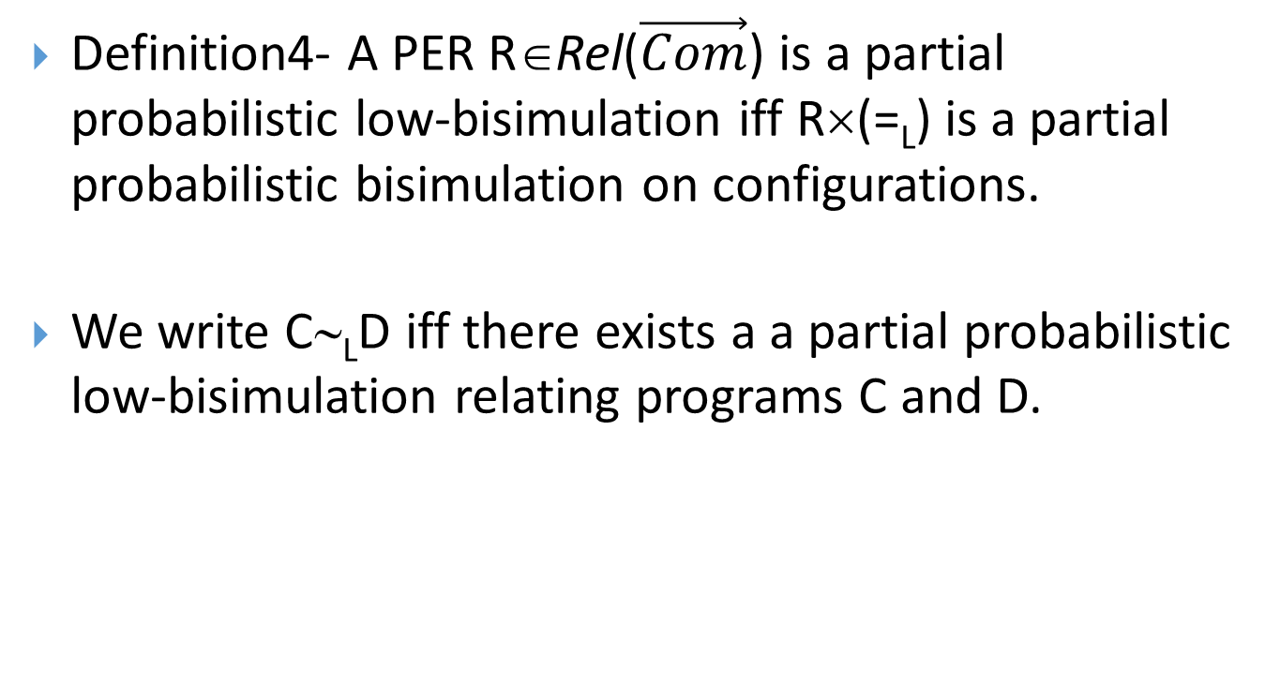
NI based on Partial Probabilistic Bisimulation
Definition4- A PER R∈Rel($\vec{Com}$) is a partial probabilistic low-bisimulation iff R×(=_{L}) is a partial probabilistic bisimulation on configurations.
We write C∼_{L}D iff there exists a a partial probabilistic low-bisimulation relating programs C and D.

Slide 38
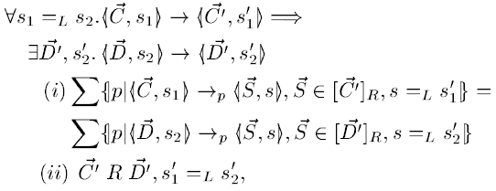


NI based on Partial Probabilistic Bisimulation (Cont.)
Proposition2 - A PER R is a partial probabilistic low-bisimulation on commands iff whenever $\vec{C}R\vec{D}$ then
The security specification for a thread pool:

Slide 39
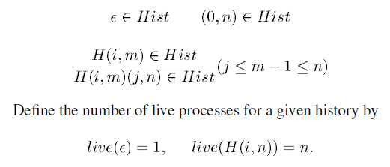
Semantics with Schedulers
Inductive definition: the set of possible histories Hist.
A history H is a sequence of pairs H∈(ℕ×ℕ)*
In each pair of the sequence, the first component is the index of the thread last chosen for computation, and the second component is the total number of threads that remained in the configuration after that thread's computation step

Slide 40

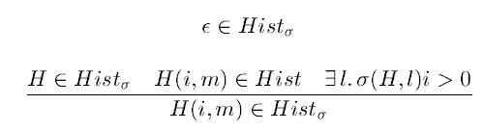
Semantics with Schedulers(Cont.)
A scheduler σ is any function that given a history H and the low part l of a state returns a probability distribution on live processes.
Given a scheduler σ not all histories are feasible under σ. Define the set of σ-feasible histories Hist_{σ}⊆Hist by

Slide 41
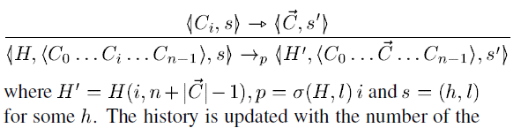
Semantics with Schedulers(Cont.)

Slide 42

Probabilistic NI with Schedulers
Let us capture the degree of how the history can vary by defining a relation =_{σ} on σ-feasible histories. It relates σ-feasible histories which are indistinguishable for σ.
Define =_{σ}∈Rel(Hist_{σ}) to be the largest relation satisfying

Slide 43

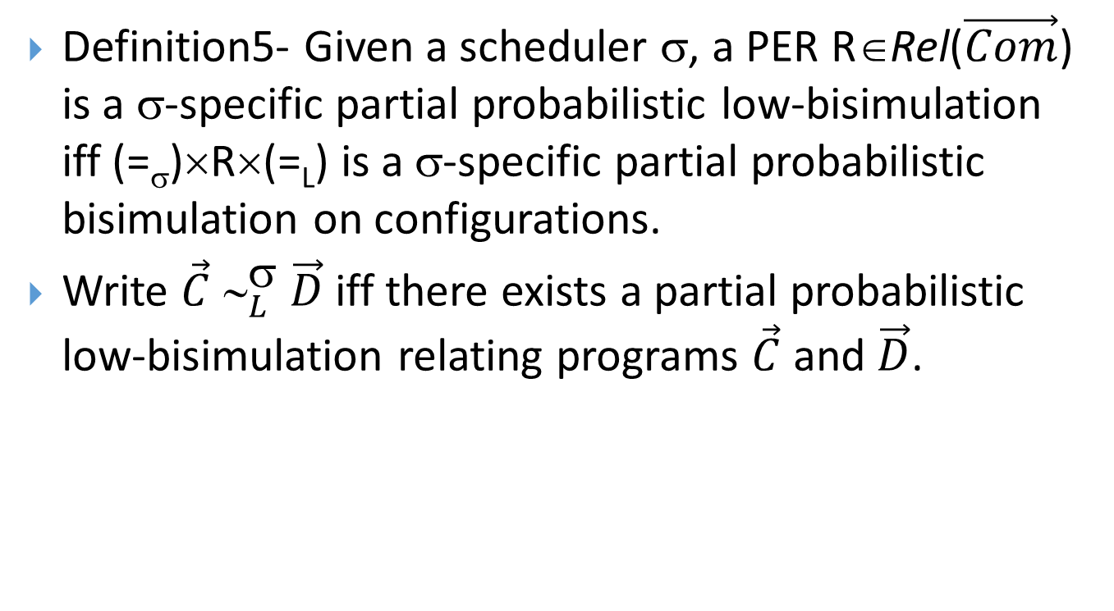
Probabilistic NI with Schedulers (Cont.)
Definition5- Given a scheduler σ, a PER R∈Rel($\vec{Com}$) is a σ-specific partial probabilistic low-bisimulation iff (=_{σ})×R×(=_{L}) is a σ-specific partial probabilistic bisimulation on configurations.
Write $\vec{C}{ ∼}_{L}^{\text{σ}} \vec{D}$ iff there exists a partial probabilistic low-bisimulation relating programs $\vec{C}$ and $\vec{D}$.

Slide 44

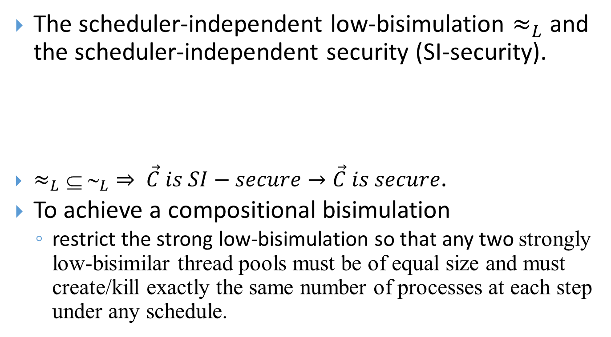
Scheduler-independent NI
The scheduler-independent low-bisimulation $≈_{L}$ and the scheduler-independent security (SI-security).
$≈_{L}⊆ ∼_{L}⇒ \vec{C} is SI−secure→\vec{C} is secure$.
To achieve a compositional bisimulation
restrict the strong low-bisimulation so that any two strongly low-bisimilar thread pools must be of equal size and must create/kill exactly the same number of processes at each step under any schedule.

Slide 45



Scheduler-independent NI (Cont.)
Definition6- Define the strong low-bisimulation $≊_{L}$to be the union of all symmetric relations R on thread pools of equal size s.t. whenever
then

Slide 46
Conclusion
Definition of Probabilistic NI
A survey on related works
Pros and Cons
Probabilistic Noninterference for Multi-threaded Programs
Strong Security
Future work:
full-featured languages
dynamic mechanisms
widening attacker observations
more permissive NI notion

Slide 47
References
[1] Zdancewic, Steve, and Andrew C. Myers. "Observational determinism for concurrent program security." In Computer Security Foundations Workshop, 2003. Proceedings. 16th IEEE, pp. 29-43. IEEE, 2003.
[2] Volpano, Dennis, and Geoffrey Smith. "Probabilistic noninterference in a concurrent language1." Journal of Computer Security 7, no. 2-3 (1999): 231-253.
[3] Sabelfeld, Andrei, and David Sands. "Probabilistic noninterference for multi-threaded programs." In Computer Security Foundations Workshop, 2000. CSFW-13. Proceedings. 13th IEEE, pp. 200-214. IEEE, 2000.
[4] Popescu, Andrei, Johannes Hölzl, and Tobias Nipkow. "Formalizing probabilistic noninterference." In International Conference on Certified Programs and Proofs, pp. 259-275. Springer International Publishing, 2013.
[5] Smith, Geoffrey. "Improved typings for probabilistic noninterference in a multi-threaded language." Journal of Computer Security 14, no. 6 (2006): 591-623.
[6] Mantel, Heiko, and Henning Sudbrock. "Flexible scheduler-independent security." In European Symposium on Research in Computer Security, pp. 116-133. Springer Berlin Heidelberg, 2010.
[7] Popescu, Andrei, Johannes Hölzl, and Tobias Nipkow. "Formal verification of language-based concurrent noninterference." Journal of Formalized Reasoning 6, no. 1 (2013): 1-30.
[8] Askarov, Aslan, Stephen Chong, and Heiko Mantel. "Hybrid monitors for concurrent noninterference." In 2015 IEEE 28th Computer Security Foundations Symposium, pp. 137-151. IEEE, 2015.
[9] Boudol, Gérard, and Ilaria Castellani. "Noninterference for concurrent programs and thread systems." Theoretical Computer Science 281, no. 1 (2002): 109-130.

Slide 48
References
[10] Russo, Alejandro, and Andrei Sabelfeld. "Securing interaction between threads and the scheduler." In 19th IEEE Computer Security Foundations Workshop (CSFW'06), pp. 13-pp. IEEE, 2006.
[11] Smith, Geoffrey. "A New Type System for Secure Information Flow." In csfw, vol. 1, p. 4. 2001.
[12] Popescu, Andrei, Johannes Hölzl, and Tobias Nipkow. "Noninterfering schedulers." In International Conference on Algebra and Coalgebra in Computer Science, pp. 236-252. Springer Berlin Heidelberg, 2013.
[13] Smith, Geoffrey. "Probabilistic noninterference through weak probabilistic bisimulation." In Computer Security Foundations Workshop, 2003. Proceedings. 16th IEEE, pp. 3-13. IEEE, 2003.
[14] Popescu, Andrei, Johannes Hölzl, and Tobias Nipkow. "Proving concurrent noninterference." In International Conference on Certified Programs and Proofs, pp. 109-125. Springer Berlin Heidelberg, 2012.
[15] Russo, Alejandro, and Andrei Sabelfeld. "Security for multithreaded programs under cooperative scheduling." In International Andrei Ershov Memorial Conference on Perspectives of System Informatics, pp. 474-480. Springer Berlin Heidelberg, 2006.
[16] Agat, Johan. "Transforming out timing leaks." In Proceedings of the 27th ACM SIGPLAN-SIGACT symposium on Principles of programming languages, pp. 40-53. ACM, 2000.
[17] Iranmanesh, Zeinab, and Mehran S. Fallah. "Specification and static enforcement of scheduler-independent noninterference in a middleweight Java." Computer Languages, Systems & Structures 46 (2016): 20-43.
[18] Focardi, Riccardo, and Roberto Gorrieri. "A Classification of Security Properties for Process Algebras1." Journal of Computer security 3, no. 1 (1995): 5-33.

Slide 49

Any Questions?

